Slide 1

HOTEL BOOKING
Project Type - EDA
PRESENTED BY
BHAGWATI PRAJAPAT & CHANDAN VARIYA
GUIDE BY - ABHISHEK WAHWAL

Slide 2
Summary of my project
This Project was given to us by the Abhishek sir with an intention to understand the Business done by Hotel Group.
This Dataset had two hotels City Hotel and Resort Hotel.
The data provided was for 3 years 2015 , 2016 and 2017.we also have the revenue and booking details with number of days of stay and booking cancellation, total number of guests including children. It also specifies guests wait period for booking , repetition of guests, their food choices among others. The data also gives us an analyzation of countries from which bookings have been done. We also a agent and other channels who also help in business by booking rooms for guests on the resort and city hotel behalf.
The data is divided between city hotel and resort hotel. Hence we can make a fair comparison between both.
Before visualize any data from the data set We will do the data cleaning as to fill any null values and delete any duplicated values and after that we have to do data wrangling.
Also we will do our analysis for both city and resort as individual businesses and in comparison to one another. We will also take help of charts for better analysis.

Slide 3
Problem Statement
This data set contains booking information for a city hotel and a resort hotel, and includes information such as when the booking was made, the number of adults, children, and/or babies, and the number of available parking spaces, which agent made the booking, among other things.
The objective of this project is Explore and analyze the data to discover important factors that govern the bookings.

Slide 4
*Let’s Starts*

Slide 5
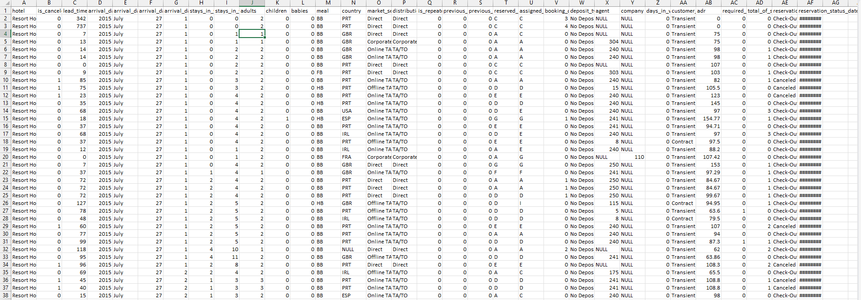
Dataset First View

Slide 6
Columns name we have 119390 index sand 31 columns
Hotel, is_canceled lead_time, arrival_date_year, arrival_date_month, arrival_date_week_number, arrival_date_day_of_month, stays_in_weekend_nights, stays_in_week_nights, adults, children, babies ,meal, country, market_segment, distribution_channel, is_repeated_guest, previous_cancellations, previous_bookings_not_canceled, reserved_room_type, assigned_room_type, booking_changes, deposit_type, agent, company, days_in_waiting_list, customer_type, adr, required_car_parking_spaces, total_of_special_requests, reservation_status, reservation_status_date

Slide 7
What did you know about your dataset?
1.The given dataset is of Hotel Booking and we have to analyze and explore this dataset to discover important factors which affects the Hotel Booking. This dataset has 119390 rows and 32 columns.
2. The duplicate value count is 31994 rows.
3. There are 4 columns in dataset which is having missing values and those columns are company, agent, country and children.
4. There are separate columns called adults, children and babies that show the total number of people who are coming to visit, so instead of different columns will add these three in one called total_num_people

Slide 8
Dataset Info
Column Non-Null Count Dtype
0 hotel 119390 non-null object
1 is_canceled 119390 non-null int64
2 lead_time 119390 non-null int64
3 arrival_date_year 119390 non-null int64
4 arrival_date_month 119390 non-null object
5 arrival_date_week_number 119390 non-null int64
6 arrival_date_day_of_month 119390 non-null int64
7 stays_in_weekend_nights 119390 non-null int64
8 stays_in_week_nights 119390 non-null int64
9 adults 119390 non-null int64
10 children 119386 non-null float64
11 babies 119390 non-null int64
12 meal 119390 non-null object
13 country 118902 non-null object
14 market_segment 119390 non-null object
15 distribution_channel 119390 non-null object
Column Non-Null Count Dtype
16 is_repeated_guest 119390 non-null int64
17 previous_cancellations 119390 non-null int64
18 previous_bookings_not_canceled 119390 non-null int64
19 reserved_room_type 119390 non-null object
20 assigned_room_type 119390 non-null object
21 booking_changes 119390 non-null int64
22 deposit_type 119390 non-null object
23 agent 103050 non-null float64
24 company 6797 non-null float64
25 days_in_waiting_list 119390 non-null int64
26 customer_type 119390 non-null object
27 adr 119390 non-null float64
28 required_car_parking_spaces 119390 non-null int64
29 total_of_special_requests 119390 non-null int64
30 reservation_status 119390 non-null object
31 reservation_status_date 119390 non-null object
Data types: float64(4), int64(16), object(12)

Slide 9
Variables Description
hotel - Type of hotel(Resort or City).
is_canceld - If there was booking cancel(0) or not(1).
lead time - The number of days between time books their room to arrive hotel.
arrival_date_year - Year of arrival date.
arrival_date_month - Month of arrival date.
arrival_date_week_number - Week no. of year for arrival date.
stays_in_weekend_nights - No. of weekend nights(Saturday or Sunday) spend by guest at hotel.
stays_in_week_nights -No. of weeknight( Mon to Fri) spend by guest at hotel.
adults - No. of adults among guest.
children - No. of children among guest.

Slide 10
Variables Description
babies - No. of babies among guest.
meal - Type of meal booked by guest.
country - Country of guest.
market_segment - grouping into categories based on their booking patterns and travel habits.
distribution_channel - Name of booking distribution channel.
is_repeated_guest - If the booking was from repeated by guest(1) or not(0).
previous_cancelletions - No. of previous booking that were cancelled by the customer prior to the customer booking.
previous_booking_not_canceled - No. of previous booking that were not cancelled by the customer prior to the customer booking.
reserved_room_type - Code of room type reserved.
assigned_room_type - code of room type reserved.
booking_changes - No. of changes made to the booking.

Slide 11
Variables Description
deposit_type - Type of the deposit made by the guest.
agent - Id of the agent who made the booking.
company - Id of the company that made the booking.
days_in_waiting_list - No. of days the booking on the waiting list.
customer_type - Type of customer, assuming one of four categories.
adr - (Average Daily Rate) dividing the sum of lodgging transaction by the total number of staying night.
required_car_parking_spaces - No. of car parking spaces required by the customer.
total_of_special_request - No. of special request made by the customer.
reservation_request - Reservation status
reservation_request_date - Date of last reservation status updated.

Slide 12
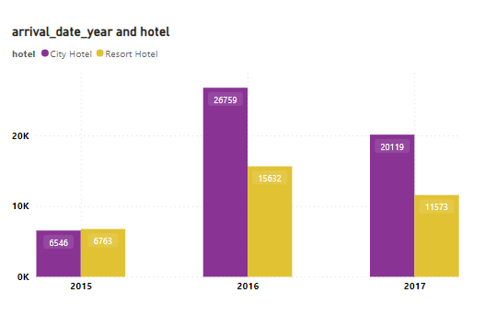
Visualisation of duplicated value

Slide 13
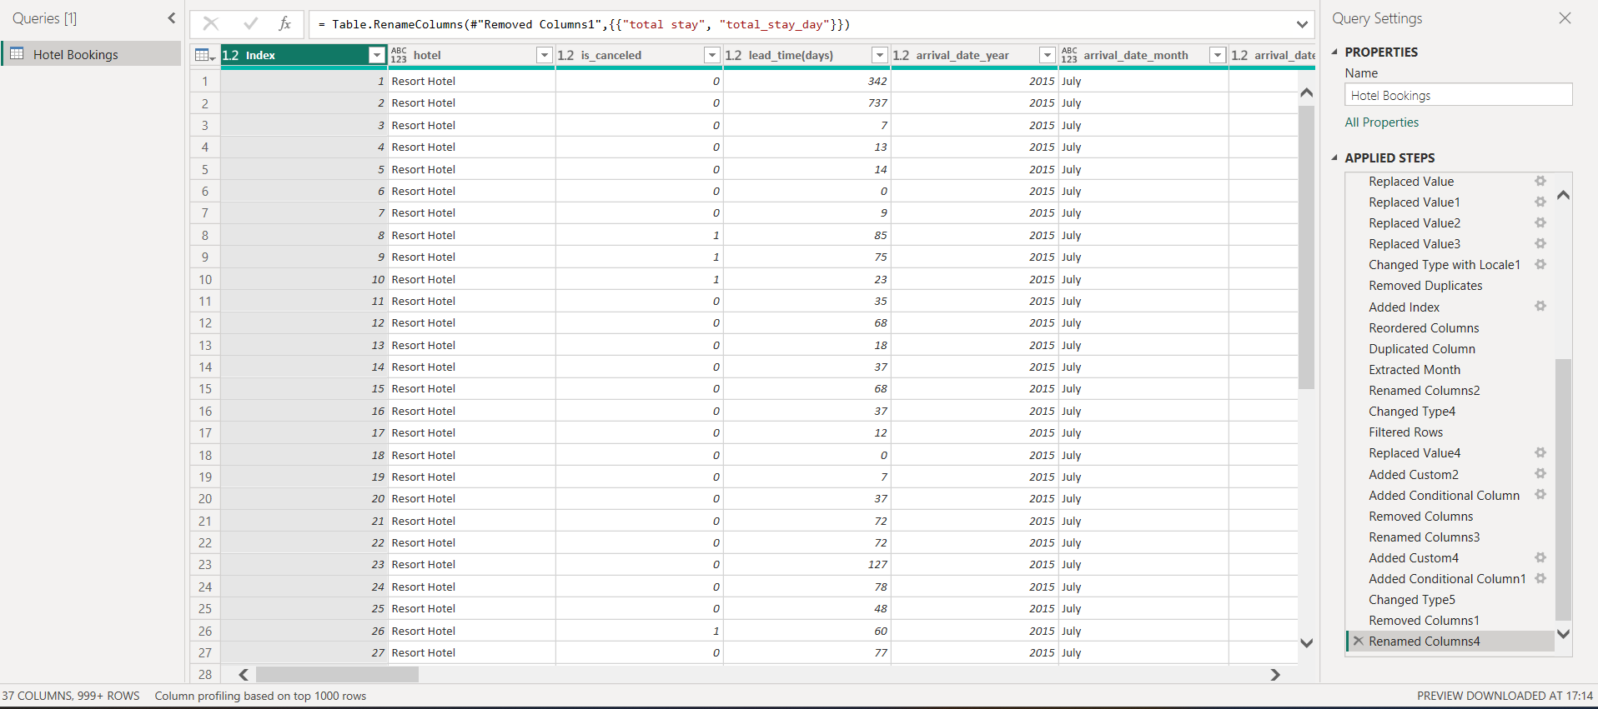
Reset index view in power quires after remove duplicate value

Slide 14
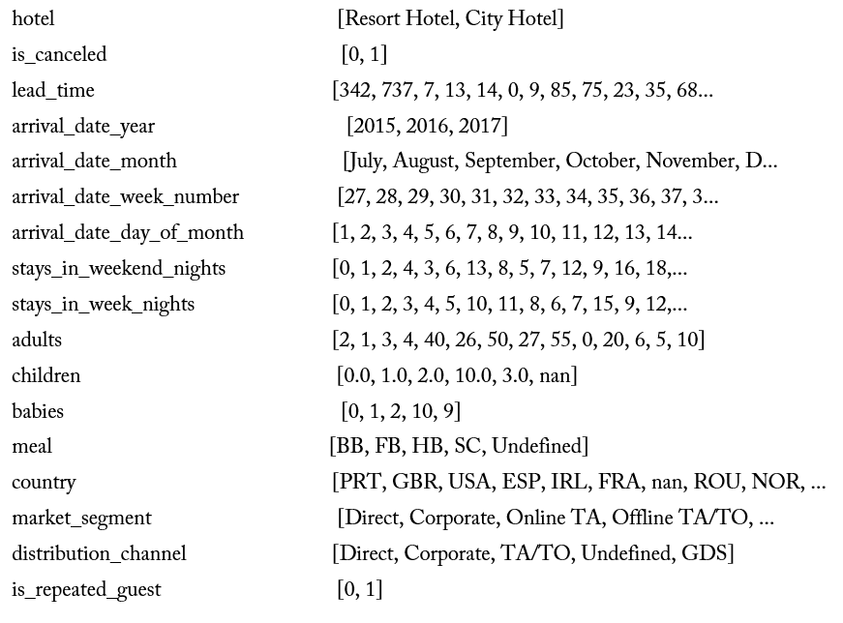
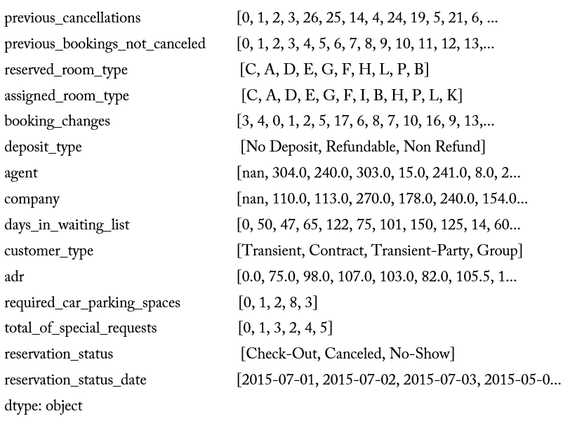
Values for each variable

Slide 15
Data Wrangling We already did some data cleaning before lets go for data Wrangling
*But we Adding*
Total staying days in hotels
Sum of adults+ child+ babies
Give Meal and Adr column description in full form
We change data type of country column into locate
We remove error from child column
We create arrival date with using column [arrival_date_year, arrival_date_month, arrival_date_day _of_month ]
We remove the all duplicates value from entire database
All the end we gives indexing

Slide 16
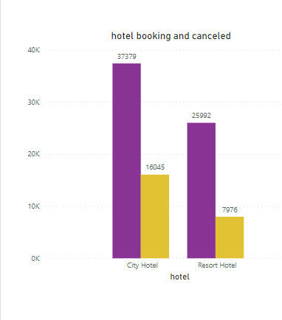
BASIC STATISTICS FIND THE TOTAL NUMBER OF BOOKINGS. CALCULATE THE CANCELLED BOOKINGS OF HOTELS.
Here We have 4 Types of Data that's Why We Used Column Chart in this Question.
The Booking Ratio of Hotels is as follows:-
A. Resort Hotel : 25992
B. City Hotel : 37379
The Canceled Ration Of Hotel is As Follows:-
A. Resort Hotel : 7976
B. City Hotel : 16045

Slide 17
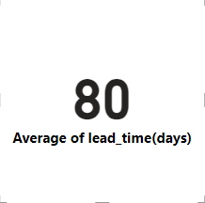
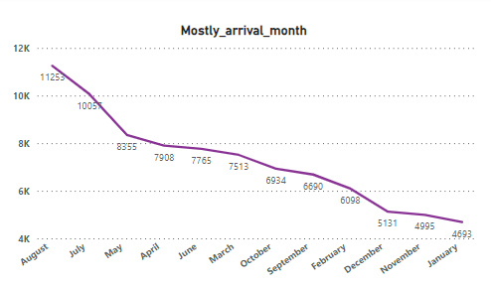
BASIC STATISTICS Identify the average lead time for bookings. Determine the most common arrival month.
Here we Identify What is the average lead time for bookings and here only one value in each We identify Than We Used Card
As per the data, the highest number of bookings occurred in the month of August, as indicated by the chart below.

Slide 18
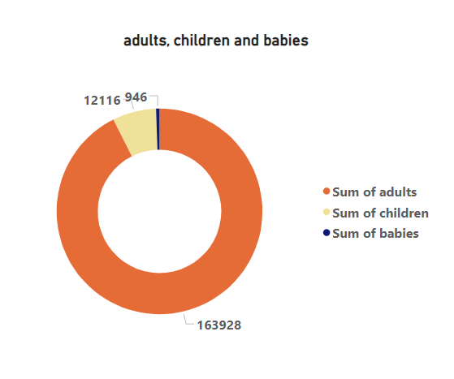
Guest Demographics In this chapter, we have covered the topic of Guest Demographics, exploring aspects such as the age group of customers making bookings.
A total of 163928 adults, 12116 children, and data for 946 babies indicate bookings at the hotels.
In this context, we have utilized a donut chart to represent data in three categories.

Slide 19
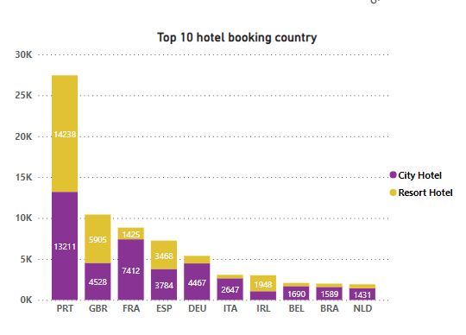
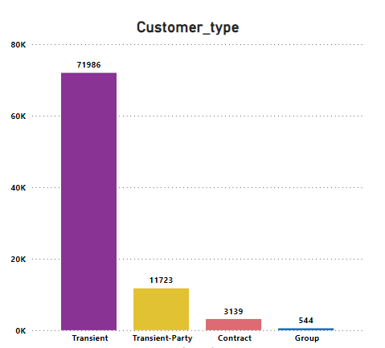
Guest Demographics variations in booking ratios across different countries, and the types of customers engaging in bookings.
We have utilized data from countries worldwide and focused on presenting the top 10 countries, as indicated below.
And We Found PRT(Portugal) is Highest booking have in this data.(I.E.27449)
In this section, we have identified the types of customers, highlighting that transient customers account for the highest number of bookings.

Slide 20
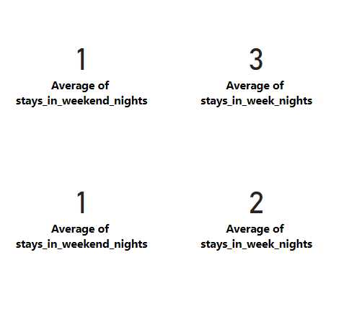
Booking Patterns In this chapter, we have Covered to reveal booking patterns, including the average length of customer stays at the hotel, including both weekend nights and week nights.
We have evaluated that, on average, customers prefer to stay for a duration of preference for both weekend nights and weeknights.
The Average Ratio of Stay Week nights is as follows:-
A. Resort Hotel : 3
B. City Hotel : 2
The Average Ratio of Stay Weekend nights is as follows:-
A. Resort Hotel : 1
B. City Hotel : 1

Slide 21
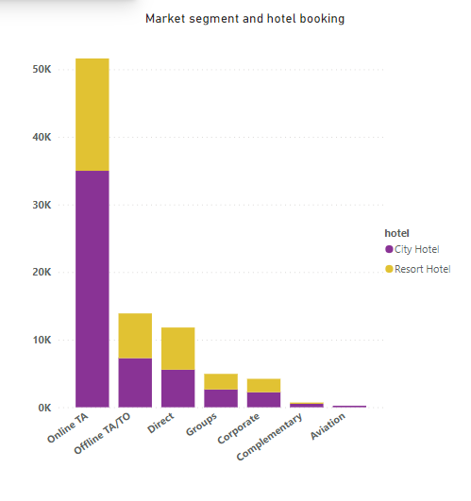
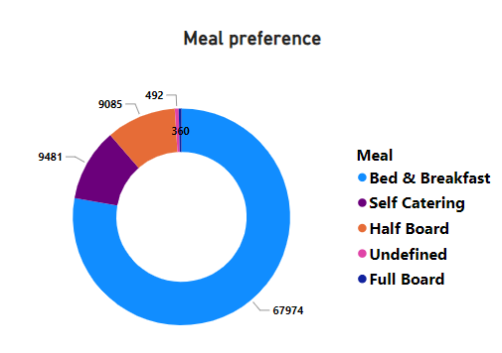
Booking Patterns
IDENTIFY THE MOST POPULAR MEAL CHOICES.
EXPLORE THE DISTRIBUTION CHANNELS AND MARKET SEGMENTS.
.
We have identified the meal preferences of customers during the booking process. Considering five different meal types, we have opted for a Pie Chart to represent this data.
Based on the previous data, we have provided a bifurcation of payment methods used by customers. The Business will benefit by understanding that their Direct bookings are very less compared to Agents booking hence they can do a brainstorming session on how can they increase the direct booking so as to not pay agent commission if paid any

Slide 22
Cancellation Analysis:
Examine the relationship between lead time and cancellations.
Generally, there is a notable correlation between the length of the lead time, i.e., the duration between booking and the actual stay, and the likelihood of cancellations. Longer lead times often correspond to a higher probability of cancellations, as travel plans may change or unforeseen circumstances may arise.
Determine the most common reasons for cancellations.
Change in Plans, Financial Constraints, Health Concerns, Booking Mistakes, Unsatisfactory Reviews or Ratings, Competing Offers , Weather or Natural Disasters, Family or Personal Issues, Travel Restrictions(Changes in travel restrictions, visa issues)

Slide 23
Cancellation Analysis:
Investigate the impact of previous cancellations on current bookings.
Investigating the impact of previous cancellations on current bookings sheds light on a significant aspect of the hospitality industry. Cancellations from prior reservations can influence the decision-making process of potential guests when considering a booking. The presence of a history of cancellations may erode trust or create hesitancy among customers, potentially affecting the overall conversion rate. Hotel management must carefully analyze and address the factors contributing to past cancellations, whether they stem from external factors or internal issues. Implementing robust measures such as improved communication, flexible cancellation policies, and enhanced service quality can help rebuild confidence among potential guests. Proactive efforts to mitigate the impact of previous cancellations can contribute to a more positive perception of the hotel, encouraging future bookings and fostering customer loyalty in the competitive hospitality mark

Slide 24
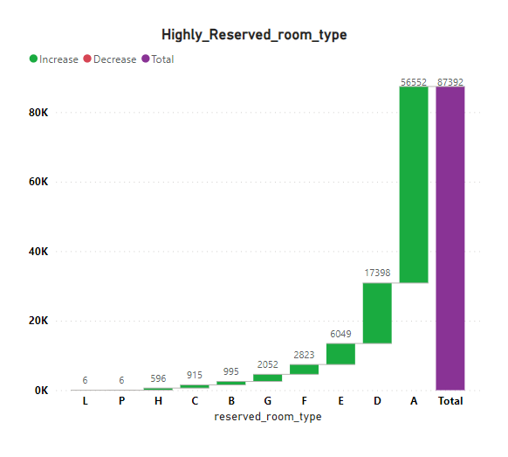
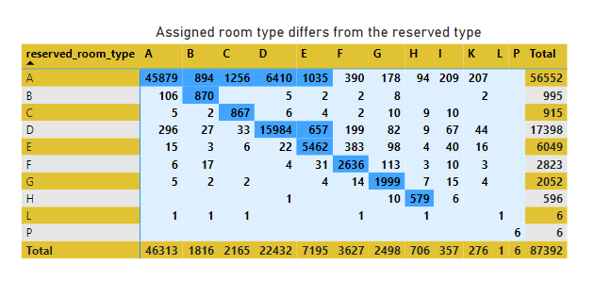
Room Assignment and Changes Explore the distribution of reserved room types. Identify cases where the assigned room type differs from the reserved type.
The management will be able to understand that the maximum bookings are done for type A and D hence they can either reduce type of rooms or get more amenities in other types. They can also give discounts.
Management should ensure that the room type booked by the customers is the one provided to them. If the management fails to do so, it may have an impact on their revenue

Slide 25
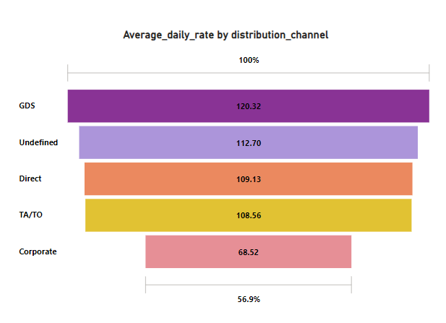
Financial Insights Calculate the average daily rate (ADR) and its distribution channels.
This chart indicates the revenue generated through various distribution channels, revealing that the highest average revenue collection of $120.32 occurred through GDS.
The management should give attention on corporate channel to grow ADR

Slide 26
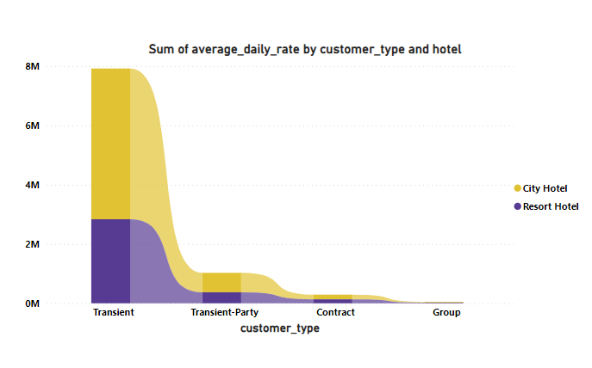
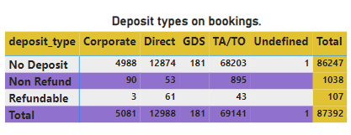
Financial Insights Evaluate the revenue generated based on different customer types. Assess the impact of deposit types on bookings.
After examining this chart, it becomes evident that transient customers prefer to frequent our hotels the most, while group bookings are comparatively lower. Therefore, management should consider offering discounts, promotions, coupons, or employing other marketing strategies specifically targeted at group bookings to increase their contribution to grow their Average Daily Rate (ADR).

Slide 27
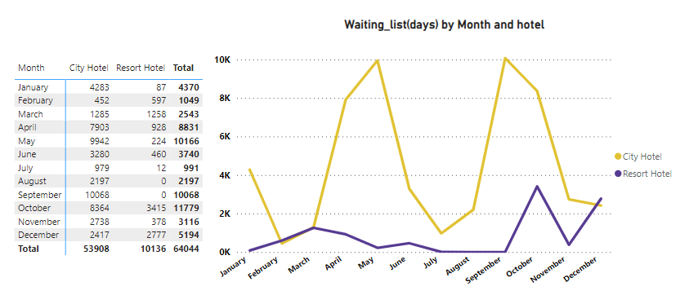
Waiting List and Special Requests Analyse the days spent on the waiting list
This chart indicates that there is the highest demand for our hotels in April-May and September-October. During these months, we should strive to increase the room inventory to meet the demand effectively.
Resort hotel need to increase their facilities so that their bookings increases.

Slide 28
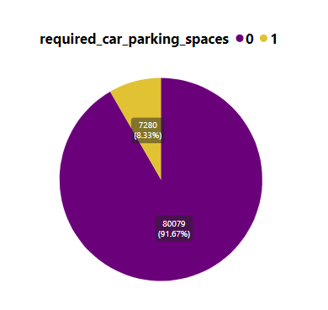
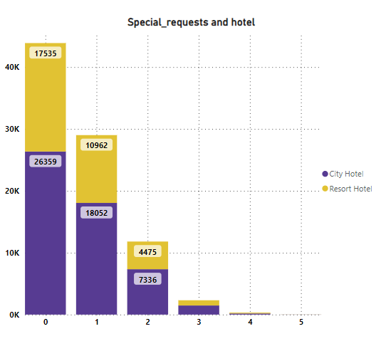
Waiting List and Special Requests Explore the distribution of special requests. Evaluate the correlation between parking spaces and booking status
I while it may seem cost-effective to avoid investing in parking facilities based on the current trend of guests not requiring parking, it's important to consider the potential long-term consequences, including customer satisfaction, competition, revenue opportunities, and adherence to local regulations. A balanced approach that takes into account both current and potential future needs of guests is essential for sustainable growth in the hospitality industry
Focusing on catering to special needs can lead to increased bookings and revenue for the hotel. By strategically managing and addressing specific requirements, the hotel can attract a broader range of guests, including those with unique needs or preference's understanding and fulfilling diverse customer needs often translate into improved financial performance and sustained growth

Slide 29
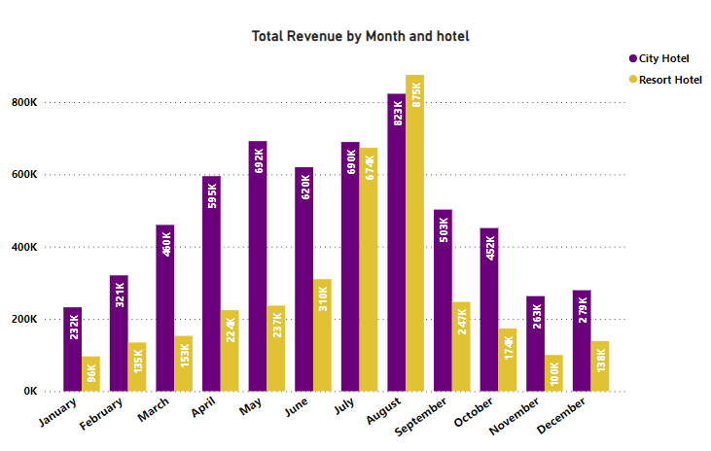
revenue Analysis Monitor the evolution of revenue from each month
During the months of April through September, there is a noticeable surge in the demand for hotel rooms, indicating a peak season for the hospitality industry. It is imperative for hotels to strategically prepare for this period, considering that these months typically experience increased occupancy. Recognizing that heightened demand often corresponds with increased competition, hotels should focus on not only managing the influx of guests efficiently but also on optimizing revenue.
Implementing dynamic pricing strategies, offering attractive packages, and capitalizing on the heightened demand can contribute to a significant boost in the average daily rate, maximizing revenue potential during these peak months. This strategic approach not only enhances the financial performance of the hotel but also ensures a seamless and profitable operation during the busy season.
A resort hotel should prioritize attention to all essential amenities to attract customers and increase the average daily rate. By focusing on providing a comprehensive range of services and facilities, the hotel can enhance its appeal to guests seeking a complete and enjoyable experience.

Slide 30
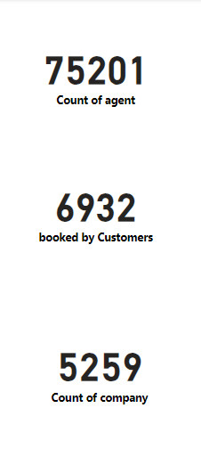
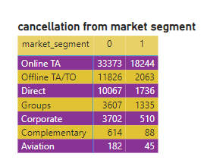
Agent and Company Analysis Investigate the performance of agents and companies in terms of bookings. Determine the impact of agents and companies on cancellations
The majority of hotel bookings were facilitated through individual agents, followed by direct bookings by customers themselves. Interestingly, the least number of bookings occurred through company channels. This pattern suggests a strong reliance on individual agents for securing accommodations, indicating that personalized services or local agents play a significant role in the booking process. It also underscores the potential for hotels to enhance direct booking channels and explore strategies to attract customers independently, thereby reducing reliance on third-party intermediaries.
Cancellation of hotel reservations can lead to fluctuations in the Average Daily Rate (ADR) and subsequently result in a decline in revenue. The changes in ADR caused by cancellations can have a direct impact on the overall financial performance of the hotel, leading to a reduction in revenue

Slide 31
Suggestion and Solution to Business Objective
During the year, the months from April to August witness a surge in hotel bookings, as it aligns with a peak period for travel enthusiasts. Recognizing this trend, it becomes imperative for hotel management to strategically focus on these months and ensure effective planning to meet the heightened demand. One key aspect is to consider increasing staff during this period to accommodate the influx of guests and maintain high-quality service standards. Additionally, meticulous attention should be given to the procurement and replenishment of essential supplies and resources necessary for seamless hotel operations during these months. By aligning staffing levels and resources with the heightened demand in the April to August timeframe, hotels can optimize their operations, enhance customer satisfaction, and capitalize on the peak travel season to maximize overall revenue.
A resort hotel should prioritize attention to all essential amenities to attract customers and increase the average daily rate. By focusing on providing a comprehensive range of services and facilities, the hotel can enhance its appeal to guests seeking a complete and enjoyable experience.

Slide 32
Result or Conclusion
In this project, we observed a preference for city hotels, with the highest bookings and revenue recorded in 2016. Since most customers do not require car parking, minimizing investment in parking facilities is advisable. July and August consistently show peak booking periods, likely due to vacations and increased travel. Bookings through agents are predominant, and guests mainly hail from Portugal, the United Kingdom, France, and Spain. A and D room categories are popular, with guests often returning to their previous choice of hotel. The inclination towards BB-type food is notable. As bookings and guest arrivals increase, the Average Daily Rate (ADR) also rises, indicating a positive correlation between ADR and the number of guests. This suggests that ADR is proportional to the number of people, highlighting the financial growth potential as occupancy rates increase

Slide 33


Slide 34
* Thankyou *

